Slide 1


Project 1 Bike Sharing Demand Analysis NextHikes IT Solutions Name: Debabrata Mallik

Slide 2
Content
Problem Statement and Project Goal
Data Loading, Merging and Cleaning
Standardizing the Data
Advanced Data Analysis
Data Visualization and Business Intelligence
Project Summary
1
2
3
4
5
6

Slide 3


Problem Statement and Project Goal
Understanding the Problem Statement:
Analyse how weather time and holidays affect bike rentals.
Use excel to merge, clean and investigate the multiple datasets.
Recommend or display significant insights to support the business.
Project Goal:
Format the data to make clearly visible for analysis by using excel functions.
Create meaningful dashboard, charts and excel inbuilt analytics tools.
Generate report for highlighting trends, insights for decision making.
Showcase the variation of user demand depending upon time and weather conditions.

Slide 4




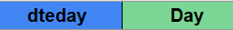
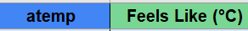
Data Loading, Merging and Cleaning
Data Loading:
Import raw data into single excel workbook from multiple excel based datasets, ensuring correct formatting and consistency for analysis.
Data Merging:
Merge data from multiple excel sheets using a common key field 'Instant' to create a unified dataset with the help of VLOOKUP function.
The combined data to be structured into meaningful rows and columns to support accurate and efficient analysis.
Data Cleaning:
Clean and structure raw data in excel by removing inconsistencies like column names, replacing missing values and standardizing formats to ensure data quality and reliability for analysis.
Renaming the column names to meaningful names as shown below (BLUE cells are existing and GREEN cells are formatted data).

Slide 5


Standardizing the Data
Data Formatting:
Format data values into meaningful text and numerical representations using Excel’s built-in functions. A snapshot of few formatted output is provided in the table below.
Column Name | Existing Value | Formatted Value | Method Used or, Considrations
Season | 1 | Spring | =IF(C2=1,"Spring","Unknown")
Year | 0 | 2011 | By referring the date column
Hour | 0 | 00:00 | =I2/24
Holiday | True or False | Yes or No | =IF(K2=FALSE,"No","Yes")
Day | 1 to 6 | Weekday or Weekend | =IF(OR(M2=0, M2=6), "Weekend", "Weekday")
Weather | 1, 2, 3 | Sunny, Cloudy or, Heavy Rain… | =IF(O2=1,"Sunny",IF(O2=2,"Cloudy",IF(O2=3,"Light Rain",IF(O2=4,"Heavy Rain"))))
Temperature | 0.24 (decimals) | Integer (°C) | =Q2*41 to get values in °C
Wind Speed | Decimals | High, Medium or Low | =IF(X2<=0.1,"Low",IF(X2<=0.3,"Medium","High"))
Note: Missing values like unexpected ‘0’ is filled up with average value from all other rows by using the formula: =IF(W2=0,AVERAGE(W:W),W2)

Slide 6
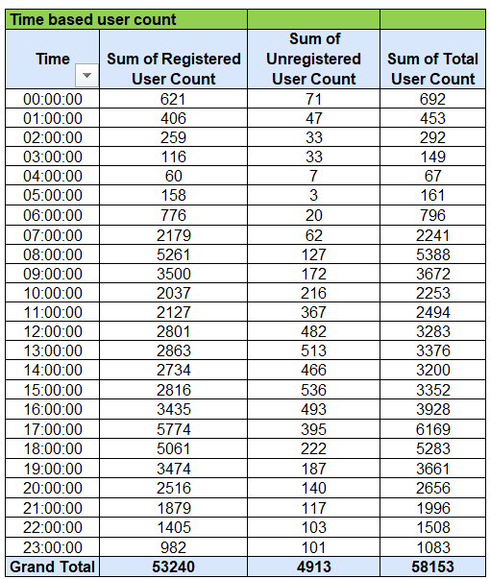
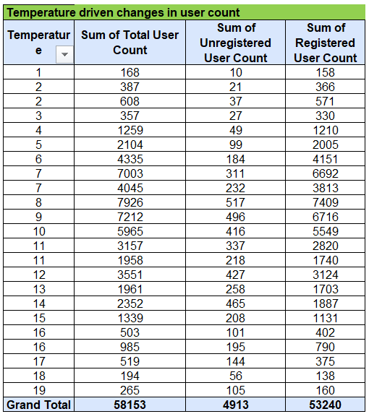
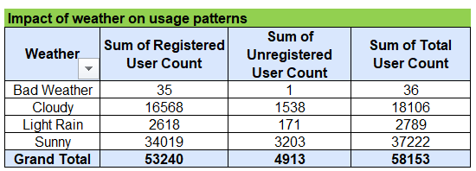
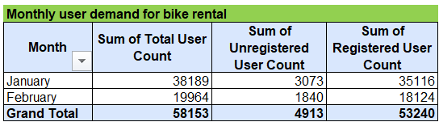
Advanced Data Analysis
Statistics using COUNTIFS, SUMIF, STDEV, CORREL
Formula:
=SUMIF('Formatted Data'!M:M,"Medium",'Formatted Data'!P:P)
Formula:
=COUNTIFS('Formatted Data'!E:E,"February",'Formatted Data'!I:I,"Sunny")
Formula:
=STDEV.S('Formatted Data'!P:P)
Formula:
=CORREL('Formatted Data'!J:J,'Formatted Data'!P:P)
Pivot Charts for summarizing the user demand
2. Pivot Table: Weather in Rows and 3 types of user count in value field.
3. Pivot Table: Month in Rows and 3 types of user count in value field.
4. Pivot Table: Temperature in Rows and 3 types of user count in value field.
1. Pivot Table: Hour in Rows and 3 types of user count in value field.
1. Time based user count
2. Impact of weather on usage patterns
3. Bike rental usage by month
4. Temperature driven changes in user count

Slide 7
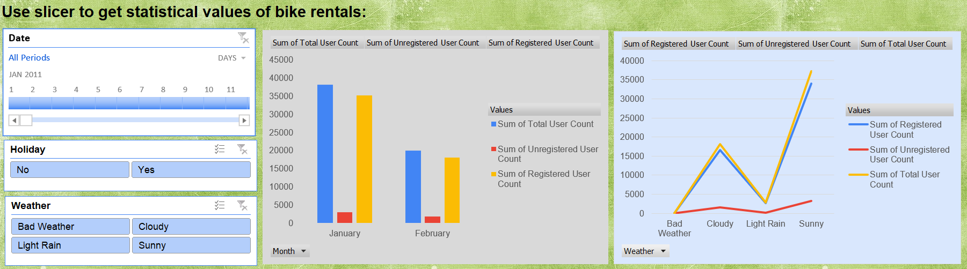
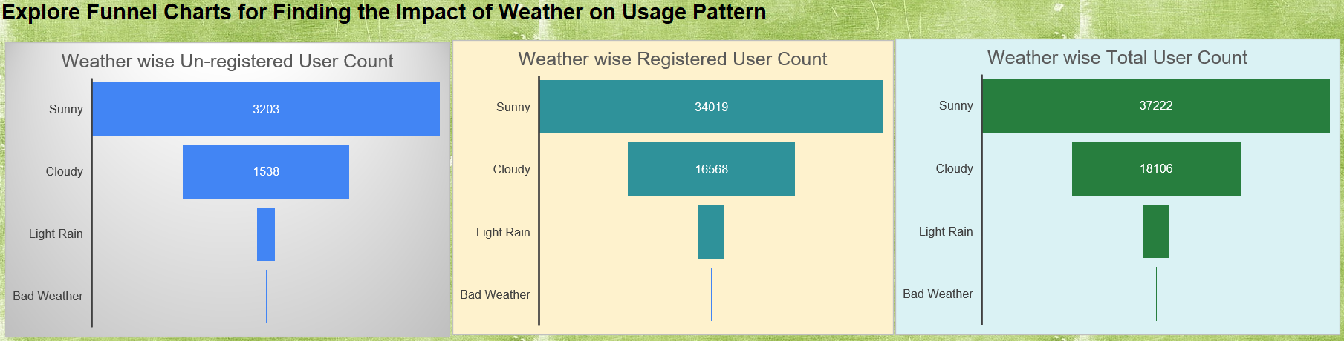
Data Visualization and Business Intelligence
Dashboard using Slicer, Timeline, Bar Chart, Line Graph
Data Comparison using Funnel Charts

Slide 8




Project Summary
Objective: To analyze bike-sharing data and identify how factors like holidays, time, and weather influence rental patterns.
Strategy:
Collected hourly and daily data on bike rentals, weather, and user types
Used Excel tools to clean, merge, and transform data
Created dashboards and reports to highlight trends and usage patterns
Critical Aspects Examined:
Time-based and seasonal bike usage behavior
Impact of weather conditions (temperature and wind speed) on user demand
Insights to support data-driven business planning
Achievements: The project resulted in a structured, cleaned dataset that enables data-driven operational planning and more accurate demand forecasting, taking into account critical influencing variables.

Slide 9



